Slide 1
Sequence analysis
FINDING STRUCTURES AND PATTERNS

Slide 2
combinatorics
Like a language composed from an alphabet, the letters are the basic building blocks
  Letters combine to form words
    Nucleotides; amino acids
  Words combine to form phrases
    binding regions/flanking; alpha-helices/beta-sheets
  phrases combine to form sentences
    Genes; proteins
  Sentences form paragraphs/discourses
    Genomes; functions/organisms

Slide 3
dna
DNA sequences (chain of nucleotides)
  ACATCATCCTTCGACGTCA ..
    A – adenine
    C – cytosine
    G – guanine
    T – thymine (U – uracil in RNA)
  Read from left to right, from 5’ end to 3’ end
  Complementary sequence
    TGTAGTAGGAAGCTGCAGT …

Slide 4
proteins
Protein/peptide sequence
  chain of amino acids
  MPRVPSASATGSSALLSLLCAFSLGRAAPFQL …
    M – methionine
    A – alanine
    L – leucine
    P – proline
    R – arginine
    V – valine
  Reported from left to right, from N-terminal end to C-terminal end

Slide 5
Sequence analysis
Compare sequences for similarity
Identify regulatory regions, gene structures, reading frames
Point mutations, SNPs
Identify organisms
Identify/measure genetic diversity
Perform function annotation of genes

Slide 6
Primary sequence analysis
Strings of nucleotides
Strings of amino residues (acids after losing a few atoms)
Strings!
Data is data

Slide 7
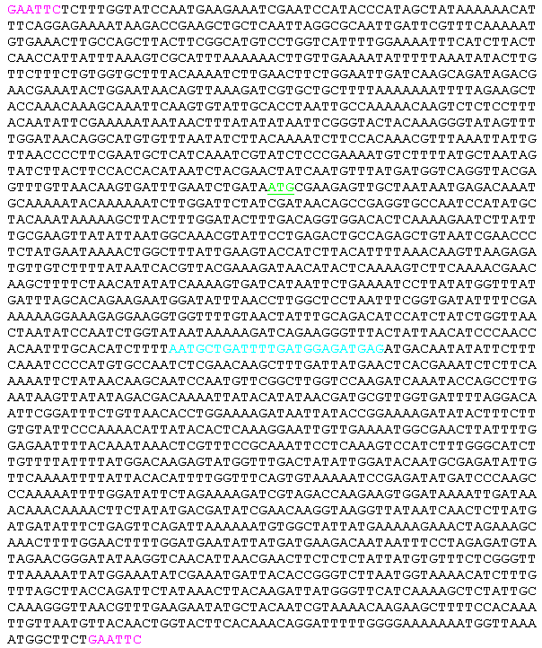

Slide 8
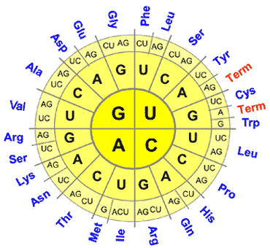
codons

Slide 9
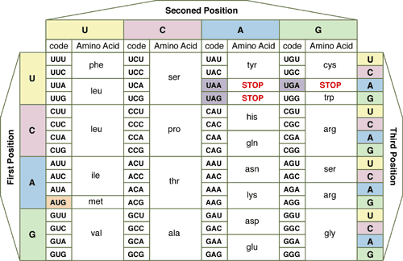
codons

Slide 10
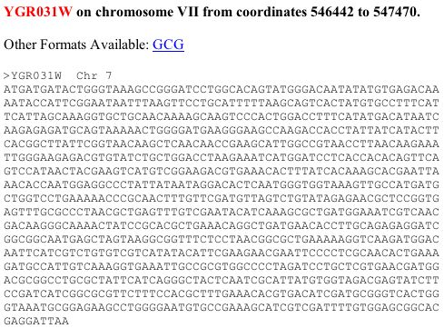
A gene

Slide 11
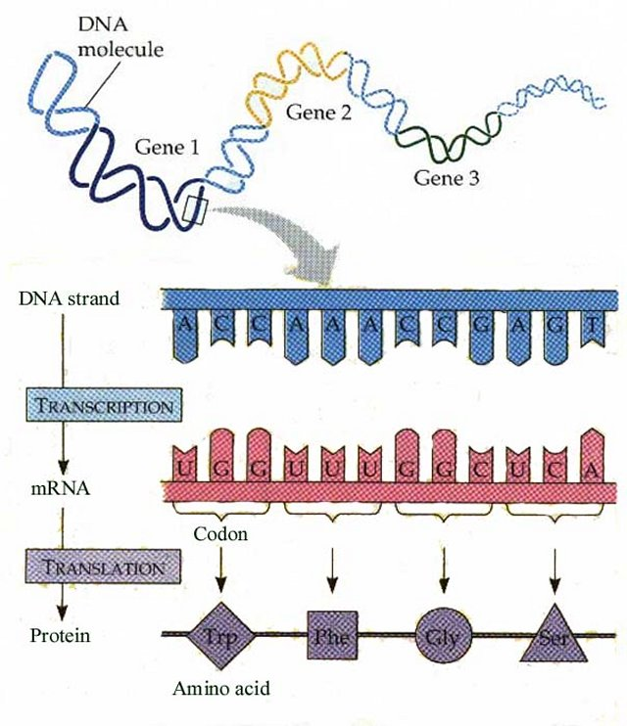

Slide 12
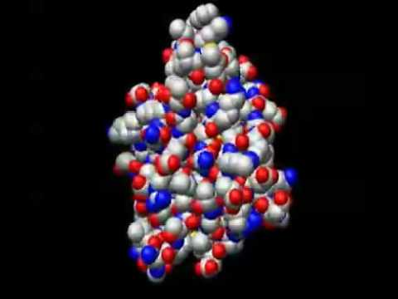

Slide 13
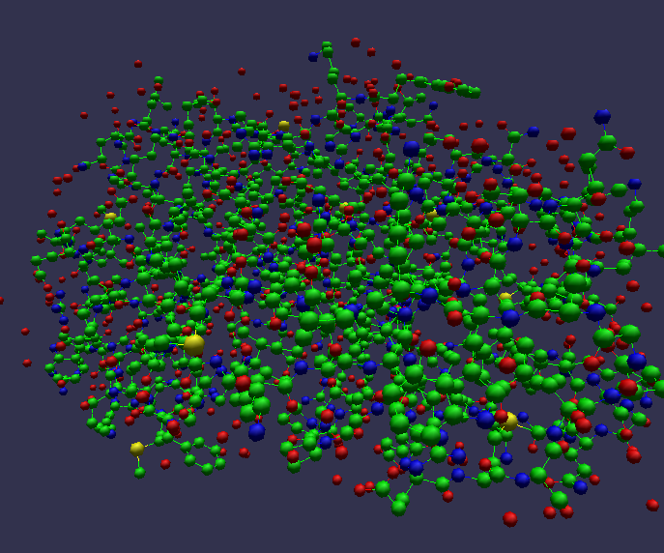

Slide 14


Slide 15
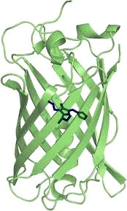

Slide 16
How long is a protein?
Yeast proteins typically around 466 amino acids
Titins (muscle sarcomere) 27,000 residues
Nascent protein
  Just translated
  Maybe modified: e.g. sugar molecules attached
  Transported to where it is needed

Slide 17
Primary sequence
68 ABP1_MAIZE 38 AUXIN-BINDING PROTEIN 1 PRECURSOR (ABP).
MAPDLSELAAAAAARGAYLAGVGVAVLLAASFLPVAESSCVRDNSLVRDISQMPQSSYGIEGLSHITV…

Slide 18
Primary sequence
68 ABP1_MAIZE 38 AUXIN-BINDING PROTEIN 1 PRECURSOR (ABP).
MAPDLSELAAAAAARGAYLAGVGVAVLLAASFLPVAESSCVRDNSLVRDISQMPQSSYGIEGLSHITV…

Slide 19
Signal peptide
68 ABP1_MAIZE 38 AUXIN-BINDING PROTEIN 1 PRECURSOR (ABP).
MAPDLSELAAAAAARGAYLAGVGVAVLLAASFLPVAESSCVRDNSLVRDISQMPQSSYGIEGLSHITV…

Slide 20
Signal peptide
Short peptide chain
  3 to 60 residues

Slide 21
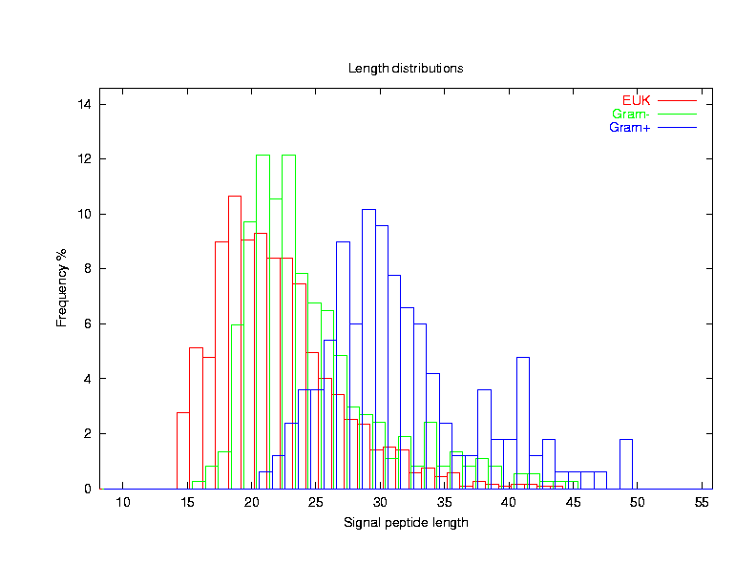

Slide 22
Signal peptide
Short peptide chain
  3 to 60 residues
Directs the transport of the protein
  Nucleus
  Endoplasmic reticulum
  Mitochondrial matrix
  Chloroplasts
  Etc
Where it can go affects what it can do

Slide 23
Raw data
50 11S3_HELAN 20 11S GLOBULIN SEED STORAGE PROTEIN G3 PRECURSOR (HELIANTH
MASKATLLLAFTLLFATCIARHQQRQQQQNQCQLQNIEALEPIEVIQAEA
SSSSSSSSSSSSSSSSSSSSCMMMMMMMMMMMMMMMMMMMMMMMMMMMMM
51 11SB_CUCMA 21 11S GLOBULIN BETA SUBUNIT PRECURSOR.
MARSSLFTFLCLAVFINGCLSQIEQQSPWEFQGSEVWQQHRYQSPRACRLE
SSSSSSSSSSSSSSSSSSSSSCMMMMMMMMMMMMMMMMMMMMMMMMMMMMM
54 1B39_HUMAN 24 HLA CLASS I HISTOCOMPATIBILITY ANTIGEN, BW-42 B*4201 ALP
MLVMAPRTVLLLLSAALALTETWAGSHSMRYFYTSVSRPGRGEPRFISVGYVDD
SSSSSSSSSSSSSSSSSSSSSSSSCMMMMMMMMMMMMMMMMMMMMMMMMMMMMM
52 21KD_DAUCA 22 21 KD PROTEIN PRECURSOR (1.2 PROTEIN).
MKLSKSTLVFSALLVILAAASAAPANQFIKTSCTLTTYPAVCEQSLSAYAKT
SSSSSSSSSSSSSSSSSSSSSSCMMMMMMMMMMMMMMMMMMMMMMMMMMMMM
51 2SS3_ARATH 21 2S SEED STORAGE PROTEIN 3 PRECURSOR (2S ALBUMIN STORAGE
MANKLFLVCATLALCFLLTNASIYRTVVEFEEDDASNPVGPRQRCQKEFQQ
SSSSSSSSSSSSSSSSSSSSSCMMMMMMMMMMMMMMMMMMMMMMMMMMMMM
55 2SS8_HELAN 25 ALBUMIN 8 PRECURSOR (METHIONINE-RICH 2S PROTEIN) (SFA8).
MARFSIVFAAAGVLLLVAMAPVSEASTTTIITTIIEENPYGRGRTESGCYQQMEE
SSSSSSSSSSSSSSSSSSSSSSSSSCMMMMMMMMMMMMMMMMMMMMMMMMMMMMM

Slide 24
Relevant data
MASKATLLLAFTLLFATCIARHQQRQQQQNQCQLQNIEALEPIEVIQAEA
SSSSSSSSSSSSSSSSSSSSCMMMMMMMMMMMMMMMMMMMMMMMMMMMMM
MARSSLFTFLCLAVFINGCLSQIEQQSPWEFQGSEVWQQHRYQSPRACRLE
SSSSSSSSSSSSSSSSSSSSSCMMMMMMMMMMMMMMMMMMMMMMMMMMMMM
MLVMAPRTVLLLLSAALALTETWAGSHSMRYFYTSVSRPGRGEPRFISVGYVDD
SSSSSSSSSSSSSSSSSSSSSSSSCMMMMMMMMMMMMMMMMMMMMMMMMMMMMM
MKLSKSTLVFSALLVILAAASAAPANQFIKTSCTLTTYPAVCEQSLSAYAKT
SSSSSSSSSSSSSSSSSSSSSSCMMMMMMMMMMMMMMMMMMMMMMMMMMMMM
MANKLFLVCATLALCFLLTNASIYRTVVEFEEDDASNPVGPRQRCQKEFQQ
SSSSSSSSSSSSSSSSSSSSSCMMMMMMMMMMMMMMMMMMMMMMMMMMMMM
MARFSIVFAAAGVLLLVAMAPVSEASTTTIITTIIEENPYGRGRTESGCYQQMEE
SSSSSSSSSSSSSSSSSSSSSSSSSCMMMMMMMMMMMMMMMMMMMMMMMMMMMMM
MAKISVAAAALLVLMALGHATAFRATVTTTVVEEENQEECREQMQRQQMLSH
SSSSSSSSSSSSSSSSSSSSSSCMMMMMMMMMMMMMMMMMMMMMMMMMMMMM

Slide 25
Separate signal peptide
MASKATLLLAFTLLFATCIAR HQQRQQQQNQCQLQNIEALEPIEVIQAEA…
MARSSLFTFLCLAVFINGCLSQ IEQQSPWEFQGSEVWQQHRYQSPRACRLE…
MLVMAPRTVLLLLSAALALTETWAG SHSMRYFYTSVSRPGRGEPRFISVGYVDD…
MKLSKSTLVFSALLVILAAASAA PANQFIKTSCTLTTYPAVCEQSLSAYAKT…
MANKLFLVCATLALCFLLTNAS IYRTVVEFEEDDASNPVGPRQRCQKEFQQ…
MARFSIVFAAAGVLLLVAMAPVSEAS TTTIITTIIEENPYGRGRTESGCYQQMEE…
MAKISVAAAALLVLMALGHATAF RATVTTTVVEEENQEECREQMQRQQMLSH…
MGNNCYNVVVIVLLLVGCEKVGAVQ NSCDNCQPGTFCRKYNPVCKSCPPSTFSS…
MPRVPSASATGSSALLSLLCAFSLGRAAPFQ LTILHTNDVHARVEETNQDSGKCFTQSFA…
MCPRAARAPATLLLALGAVLWPAAGAW ELTILHTNDVHSRLEQTSEDSSKCVNASR…

Slide 26
Find the end of the signal peptide
Need to characterize the signal peptide, or the cleavage point, or the start of the mature protein
  Position?
  Pattern?
  Electrochemical properties?
  Some combination of all these?

Slide 27
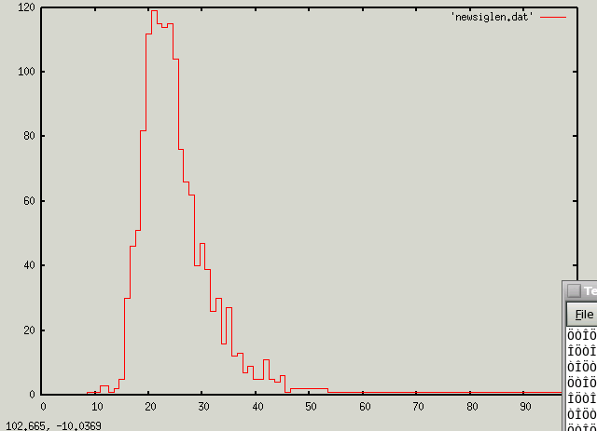
position
1418 samples; µ-length = 24

Slide 28
pattern
CIAR HQQ SSSCMMM
CLSQ IEQ SSSCMMM
TWAG SHS SSSCMMM
ASAA PAN SSSCMMM
TNAS IYR SSSCMMM
SEAS TTT SSSCMMM
ATAF RAT SSSCMMM
GAVQ NSC SSSCMMM
APFQ LTI SSSCMMM
AGAW ELT SSSCMMM
AFAY SPR SSSCMMM
SDSV TPT SSSCMMM
VISS IQD SSSCMMM
LEAQ NPE SSSCMMM
IMAE DAQ SSSCMMM
AMAA VTN SSSCMMM
VTSH LTE SSSCMMM
FLAE DVQ SSSCMMM
SLAG VLQ SSSCMMM
VSAM EPL SSSCMMM
CRSI PLD SSSCMMM

Slide 29
pattern
30 LAA
23 QAA
20 SAA
19 LAQ
19 HAA
17 FAA
14 NAA
13 EAA
13 AAA
11 QAE
10 TAA
10 SAS
10 LAE
9 VAA
9 LAD
8 SAL
8 RAA
8 MAA

Slide 30
pattern
211 AA
94 AQ
74 AE
60 AD
55 AS
35 AL
35 AK
33 AG
32 AV
29 GA
28 GS
28 AN
25 SA
25 GQ
24 AT
21 AF
20 SQ
20 AR
20 AI

Slide 31
pattern
301 A
173 Q
126 E
117 S
100 D
72 K
69 L
65 G
64 V
49 T
43 I
42 N
38 F
37 R
27 Y
27 C
26 H
17 M
14 P
11 W

Slide 32
pattern
41 L*A
32 L*Q
28 A*A
27 Q*A
27 H*A
26 S*A
20 F*A
19 N*A
19 E*A
18 S*Q
17 Q*E
17 L*S
16 S*S
16 S*E
15 V*A
14 L*D
14 F*Q
14 A*D
13 L*G

Slide 33
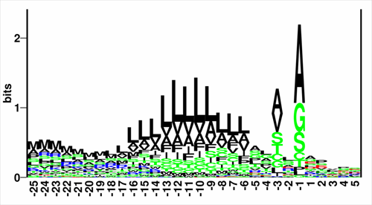

Slide 34
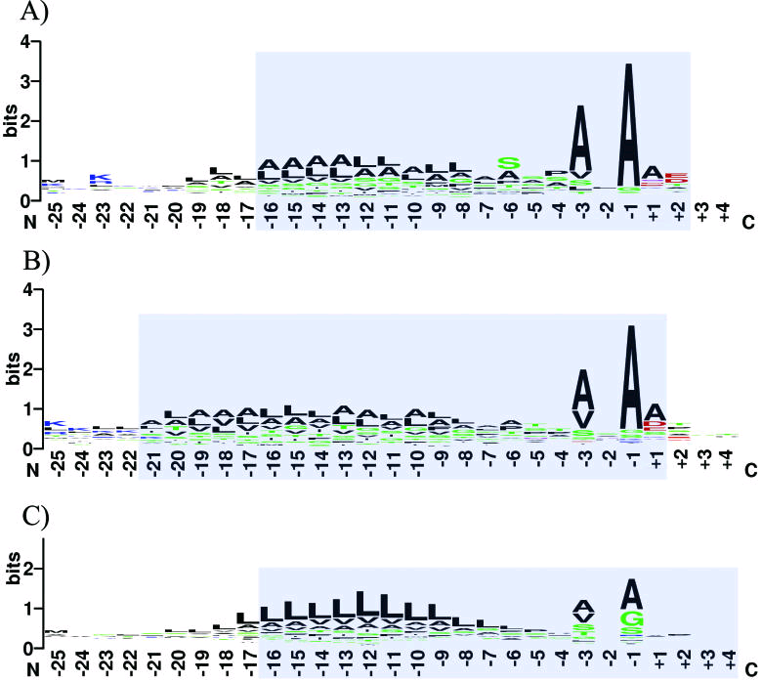

Slide 35
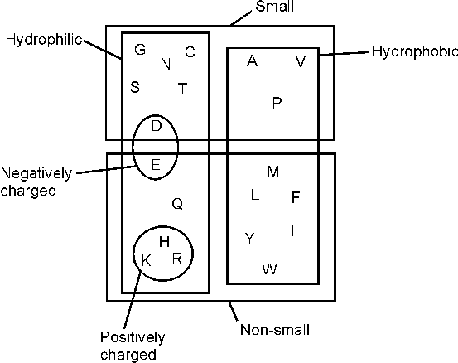
AA properties

Slide 36
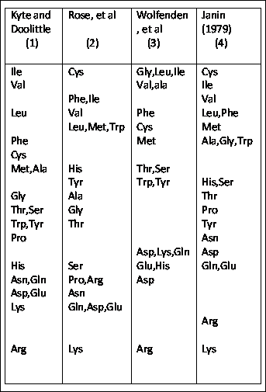

Slide 37
Regional characteristics
MAPDLSELAAAAAARGAYLAGVGVAVLLAASFLPVAESS

Slide 38
Regional characteristics
MAPDLSELAAAAAARGAYLAGVGVAVLLAASFLPVAESS
N-region
  Positively charged
  2-15 residues

Slide 39
Regional characteristics
MAPDLSELAAAAAARGAYLAGVGVAVLLAASFLPVAESS
N-region
  Positively charged
  2-15 residues
H-region
  Hydrophobic
  Typically about 8 residues

Slide 40
Regional characteristics
MAPDLSELAAAAAARGAYLAGVGVAVLLAASFLPVAESS
N-region
  Positively charged
  2-15 residues
H-region
  Hydrophobic
  Typically about 8 residues
C-region
  Typically less hydrophobic
  About 6 residues long

Slide 41
awk
A text-processing programming language
Input is lines of text
Each line is called a record
Each record is parsed into fields
  Default field separator is whitespace
  NR = number of current record
  NF = number of fields found in current record

Slide 42
awk
Awk program made up of blocks of statements/actions
A block of actions is performed when preceding condition is true
Block format:
  <condition> {stmt_1; stmt_2; … stmt_n}
  If condition is empty then defaults to always true

Slide 43
awk
Examples
  NF == 5 {print $4}
  $1 > 10 {print $1}
  $1 > 10 && $1 < 20 {print “VALID:”, $0}
  {print} equivalent to {print $0}
  {print NR, $0}
  NF == 3 {print $3, $2, $1; print $3 * 10 + $1;}

Slide 44
awk
Blocks are executed in sequence
All blocks are considered for each line of input
If we don’t want a block to execute, we need a condition that precludes it
Special conditions
  BEGIN{ }
  END{ }

Slide 45
awk
Conditional comparators:
  ==, !=, >, <, >=, <=, ~, !~
Boolean combinators:
&&, ||, !
e.g.
NF == 1 && ! $1 > 25 {print $1, $0}
All blocks are considered for each line of input
If we don’t want a block to execute, we need a condition that precludes it
Special conditions
  BEGIN{ }
  END{ }

Slide 46
Regular expressions
The true power and utility of awk lies in regular expressions (regexps)
A regexp specifies a pattern – a subset of strings
Regexp composed of
  Literals (i.e. characters, terminals)
  Operators (e.g. repetition, selection)
  Special characters (i.e. non-literal terminals)

Slide 47
regexps
a character is a regexp that matches that character
  R - matches “R”
Concatenated regexps are a regexp that matches the combined pattern
  RE - matches “RE”
A character list is a regexp that matches any one of the characters
  [RE] – matches “R” or “E”

Slide 48
regexps
A regexp in ‘closure’ is a regexp that matches zero or more repetitions of the regexp
  R* - matches zero or more R’s
  RE* - matches an “R” followed by zero or more E’s
  R[AE]*R – matches an “R” followed by zero or more A’s or E’s followed by another “R”
Alternation matches either of two regexps
R | E – matches R or matches E
Parentheses can delimit a regexp
(RE) is the same as RE
RE* vs. (RE)*

Slide 49
regexps
A character list that starts with ^ matches any character NOT in the list
R[^AE]*R - matches two R’s separated by anything other than A or E
One or more repetitions is indicated by +
RE+R - matches R followed by one or more E’s followed by another R
Zero or one instances is indicated by ?
  RE?R – matches RR or RER

Slide 50
regexps
A finite/fixed number of repetitions is specified by that number in curly braces
RX{5}R - matches RXXXXXR
A period (fullstop) matches any one character
  R.+R - matches two R’s separated by one or more characters
^ matches beginning of a string (unless it follows “[“)
$ matches end of a string

Slide 51
Special characters
^ matches beginning of a string (unless it follows “[“)
$ matches end of a string
\w matches any word-consistent character (i.e. letter, digit, underscore)
\W matches any non-word-consistent character
\+ matches + and \* matches *, etc.

Slide 52
Character classes
[:alpha:] matches any alphabetic character
[:alnum:] matches letters and digits
[:space:] matches any whitespace character, except newline
[:digit:] matches any digit
[:punct:] matches any punctuation
[:upper:] matches any uppercase letter

Slide 53
Character classes
[:alpha:] matches any alphabetic character
[:alnum:] matches letters and digits
[:space:] matches any whitespace character, except newline
[:digit:] matches any digit
[:punct:] matches any punctuation
[:upper:] matches any uppercase letter
  [:upper:]{1,3}[:digit:]{3}

Slide 54
Regexps in awk
Regular expression in awk are typically delimited by forward slashes
/ATG[ACGT]+((TA[GA])|(TGA))/
We can use regexps to select records
/^S+CM+/ {print}
Can also use regexps to select subsequences

Slide 55
Regexps in awk
{gsub(/ATG/,”M”); print;}
{
match($0,/^M.*AAA/);
print substr($0, RSTART, RLENGTH);
}
match($0,/^S+CM+/){match($0,/^S+C/);print RLENGTH;}

Slide 56
String functions in awk
gsub(r, s [,t])
  Substitute all occurrences of r with s [in t]
sub(r, s [,t])
  Substitute first occurrence of r with s [in t]
match(s, r)
  Return index of first occurrence of r in s, and make RSTART equal to that index and RLENGTH equal to the length of the matched substring; return 0 if not found
length([s])
  Return length of s (or of $0 if s not supplied)
index(s, t)
  Return index of first occurrence of t in s (or 0 if not found)
toupper(s)
  Return s with all letters in uppercase
substr(s, i [,n])
  Return substring of s starting at i-th position (for the following n characters)

Slide 57
Math in awk
+, -, *, /, %
  {t = $1 * 4 - $3; print t % 2;}
++, --
  match($NF, /^ATG/)>0 {t++;}END{print t/NR}
^ or **
+=, -=, /=, *=, %= shorthand arithmetic
sqrt(n), abs(n), log(n), exp(n), cos(n), int(n)

Slide 58
Actions/statements
if (cond) stmt;
  if ($1 > 10) t++;
if (cond) stmt1; else stmt2;
  if ($2 < $1){
  tmp = $1;
  $1 = $2;
  $2 = tmp;
  }
  else
  t++;
for( expr1; expr2; expr3)
  for (i=1;i<=NF; i++) print $i;
while (cond) stmt;
  i=2;
  while (i<=NF && $i != $1) i++;
break
exit

Slide 59
User-defined functions
e.g.
$1 ~ /^[0-9]+$/ {print myfun($1)}
function myfun(x){
if (x % 2 == 0) return “EVEN”;
return “ODD”;
}

Slide 60
Gawk – much, much more
Awk is Turing Complete
- can compute anything that is computable
Many more features:
- arrays
split(s, a, r) split string s into fields separated by r and place fields in a
for (x in a) print a[x]
- ranges
“<xml-tag>”,”<\xml-tag>” {print}
- output functions
printf
printf fmt, data
print data > file
print $1 | “sort”
next
nextfile
- built-in variables
OFS
FILENAME
IGNORECASE
CONVFMT = “%f2.2”

